Slide 1
ACL-2021
2021.12.22 • ChongQing
Reported by Changjiang Hu

Slide 2
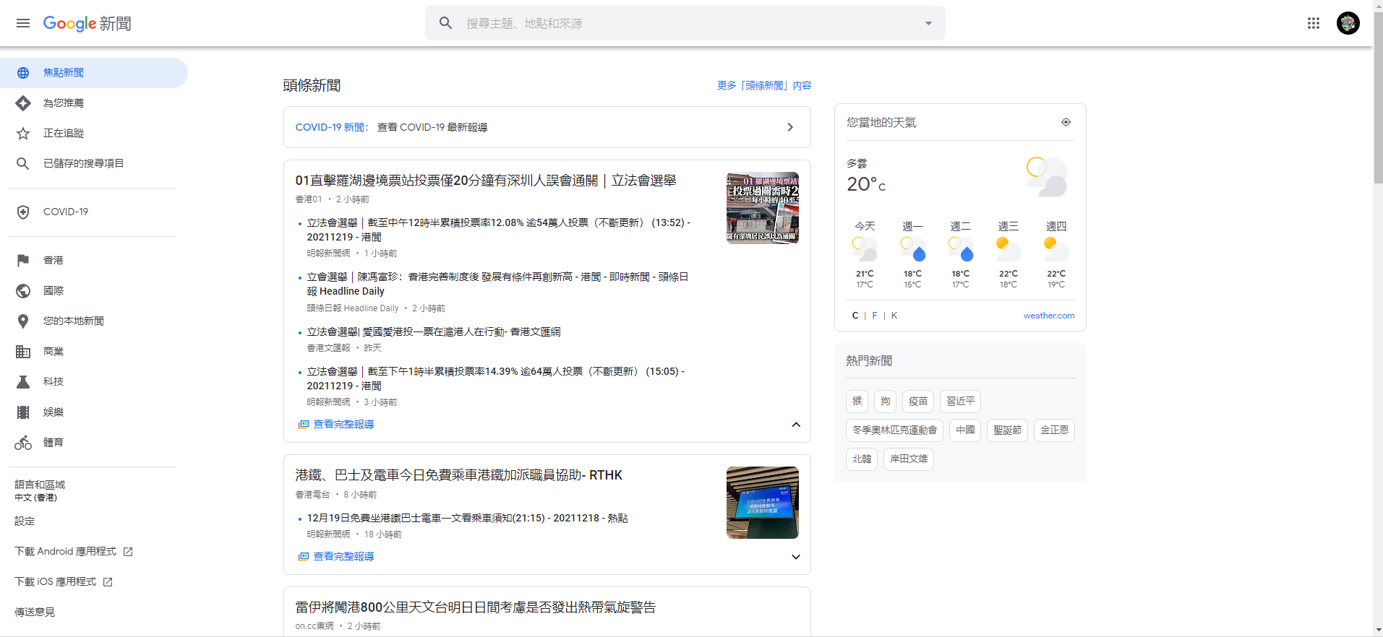
Background
Online news platforms become popular for people to read news
Users face heavy information overload on online news platforms

Slide 3
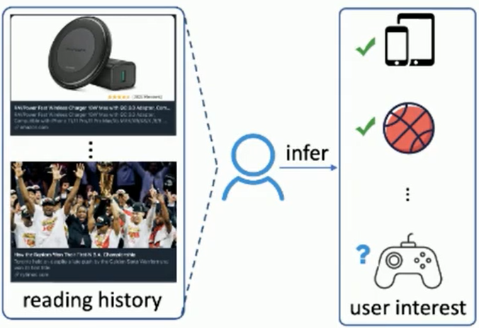
Introduction
Personalized news recommendation
Model user interests from their historical click behaviors
Recommend news based on their relevance with user interest

Slide 4
Introduction
Two problem
Difficult to provide accurate recommendation to cold-start users
Trend to recommend news with similar content

Slide 5
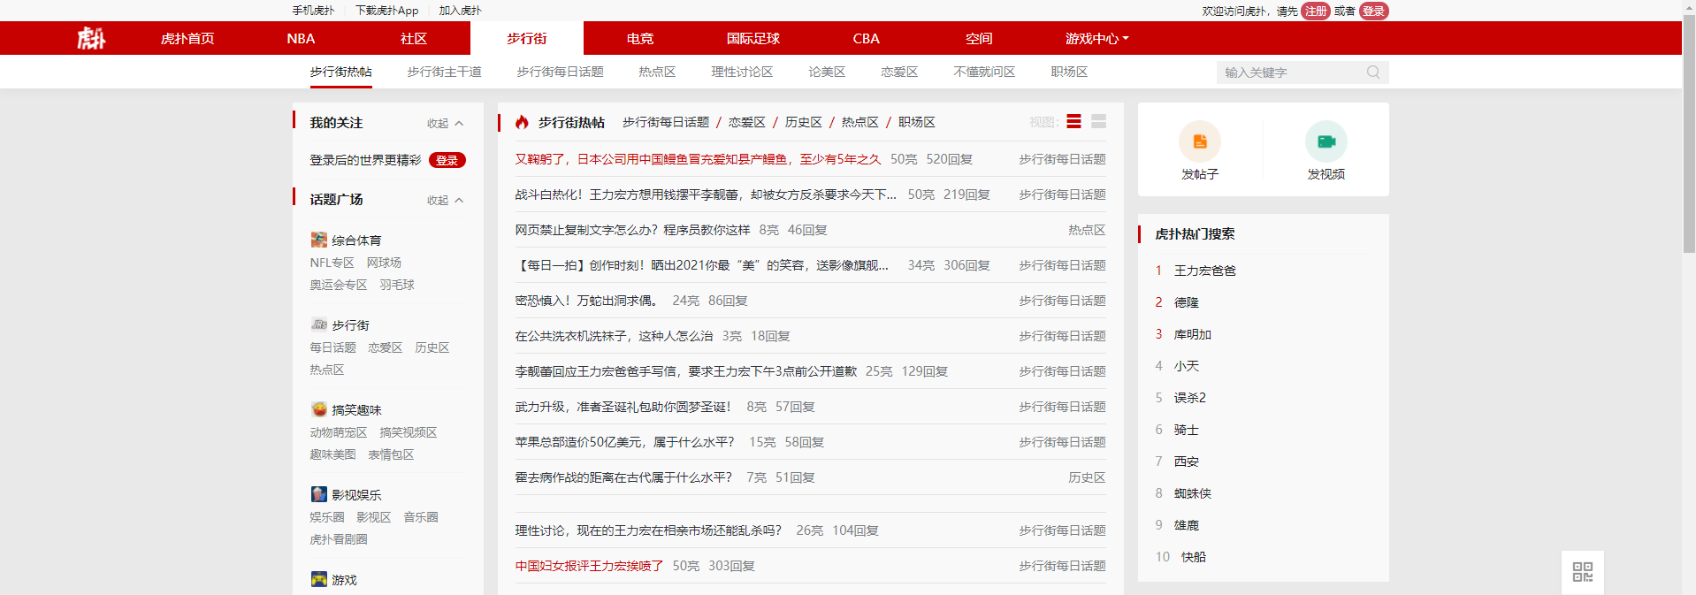
Method
Popularity-based News Recommendation
News popularity modeling: statistics of user interactions
Challenges:
view times, comments
Cannot provide personalized services

Slide 6
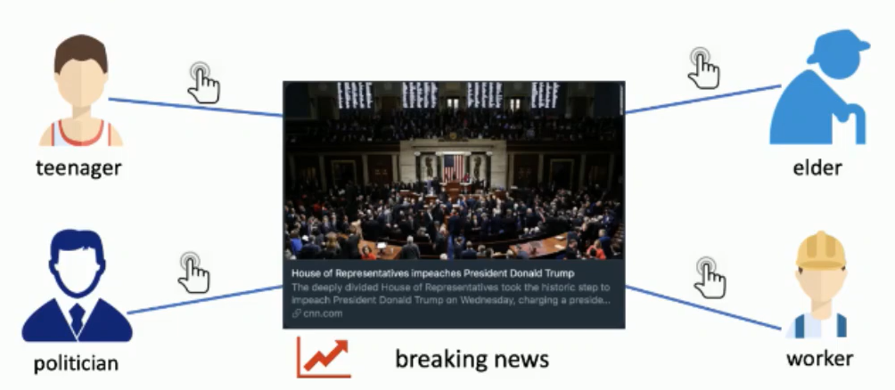
Introduction
Incorporating news popularity into personalized news recommendation
Popular news usually convey important information
Attract users with different interests to read
Improve experience of cold-start users

Slide 7
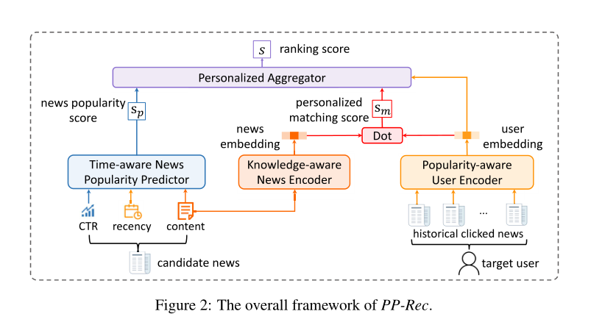
Method

Slide 8
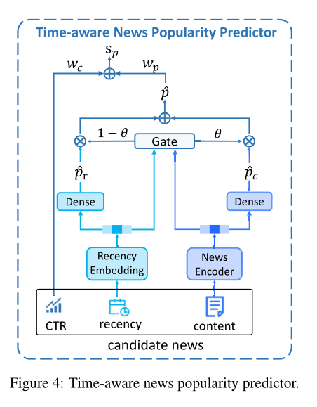
Method
We use user interactions in recent t hours to calculate near real-time CTR for news popularity prediction

Slide 9
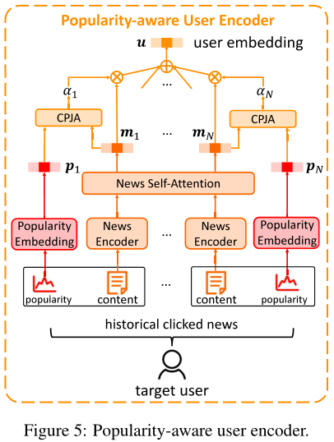
Method
Content-popularity joint attention network

Slide 10
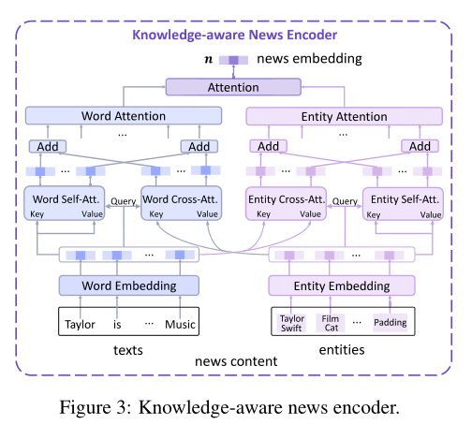
Method
the entity “MAC” that appears with the entity “Lancôme” may indicate cosmetics while it usually indicates computers when appears with the entity “iPhone”.
the entity “MAC” usually indicates computers if its textual contexts are “Why do MAC need an ARM CPU?” and indicates cosmetics if its textual contexts are “MAC cosmetics expands AR try-on”.

Slide 11
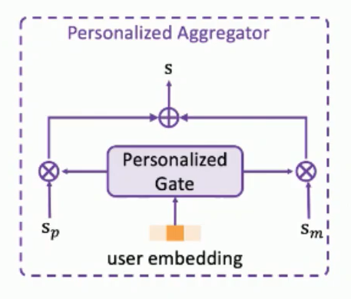
Method
News Ranking and Model Training
the gate η is computed based on the user representation u via a dense network with sigmoid activation.

Slide 12
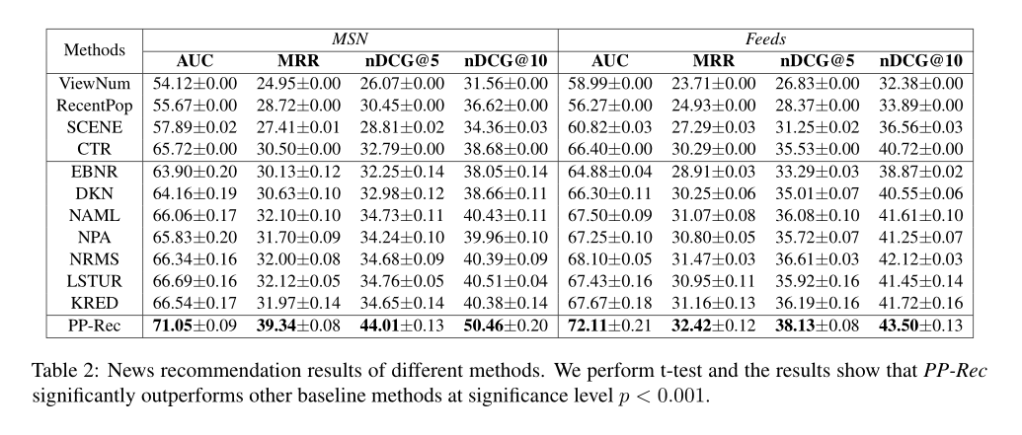
Experiment

Slide 13
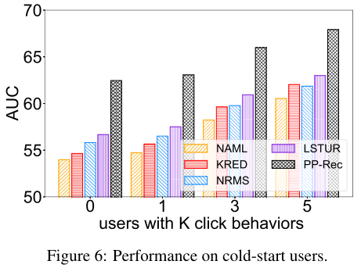
Experiments

Slide 14
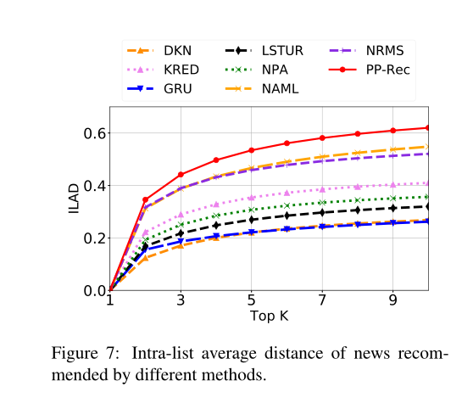
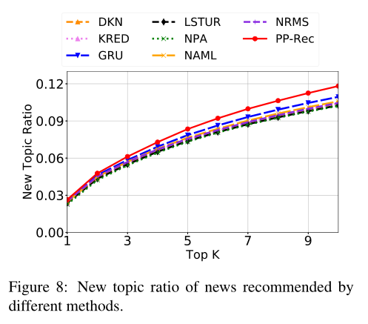
Experiments
Recommendation diversity

Slide 15
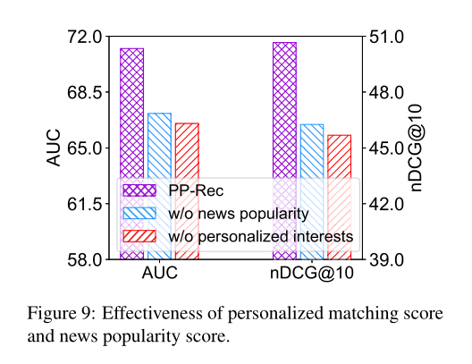
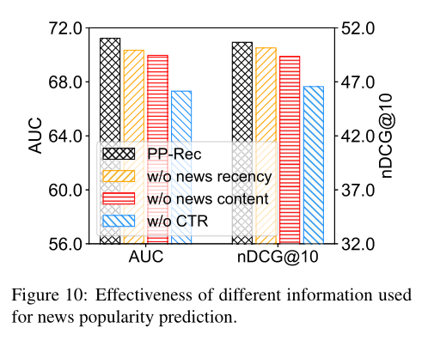
Experiments

Slide 16
Experiments
Case study

Slide 17
Thanks

